Slide 1
BambooHR CS Import
BambooHr integration

Slide 2
Steps
Add and Update data to table RPT_COM_RATE_BHR
Publish Data to bamboohr commission schedule table
Verification of TMW UserID entries

Slide 3
Add and Update data to table RPT_COM_RATE_BHR
Script Name: add-update-data-to-new-table.py

Slide 4
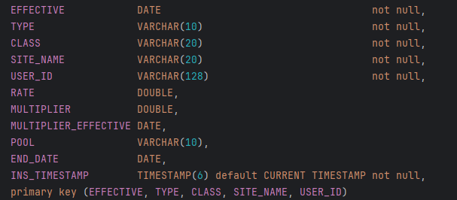
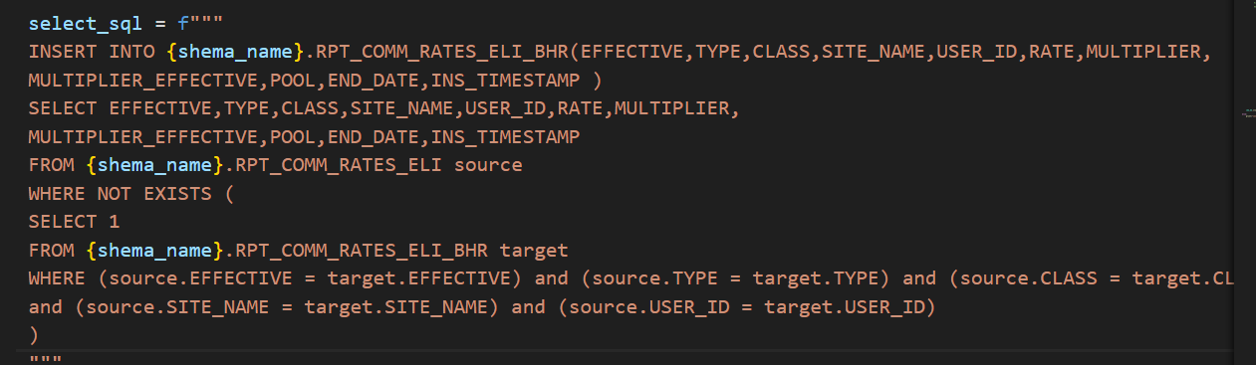
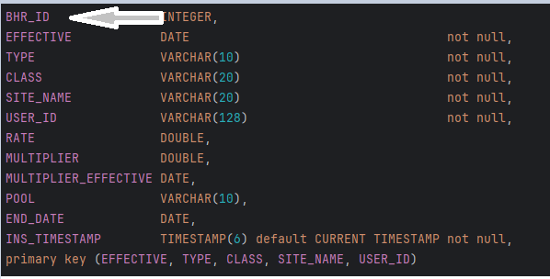
IMPORT DATA TO NEW TABLE
Missing column BHR_ID in RPT_COMM_ELI
Existence of BHR_ID in RPT_COMM_ELI_BHR
SQL request that insert by taking account contraints
RPT_COMM_ELI
RPT_COMM_ELI_BHR

Slide 5
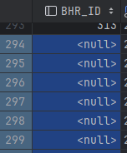
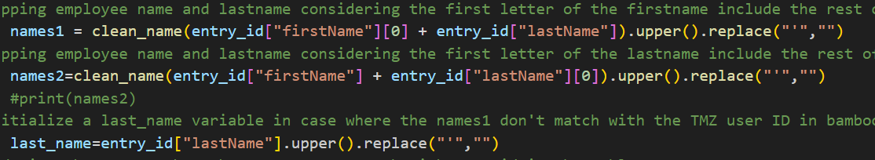
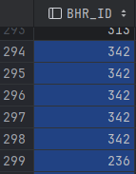
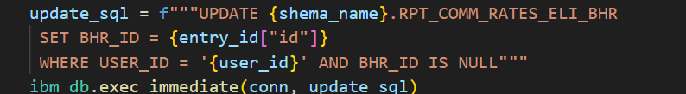
UPDATE DATA TO NEW TABLE
Missing value in BHR_ID after importing data
Mapping name by taking account exception
Browse all the employees with API bamboorh and get their id
RPT_COMM_ELI_BHR
RPT_COMM_ELI_BHR after mapping

Slide 6
Publish Data to bamboorh table: Commission schedule
Script Name: Main.py

Slide 7
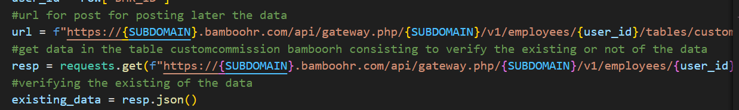
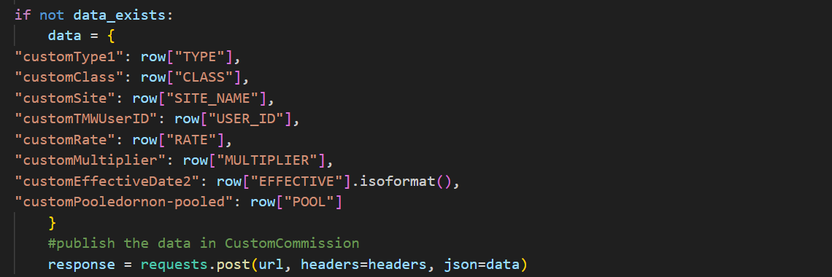
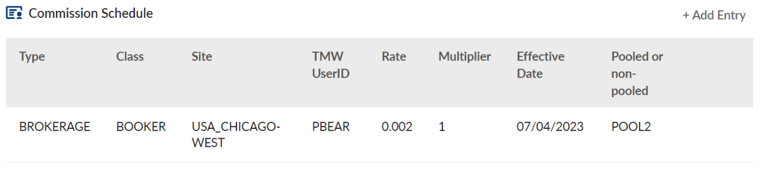
Publish DATA TO Bamboorh
Request that take most recent effective date ‘2030-01-01’
Verification existence data in bamboorh by browsing with bamboorh API
Post Data when there’s not existed
Request
Verification
Post data

Slide 8
Verification of TMWUSERID bamboorh entries
Script Name: Verify-tmw-user.py

Slide 9
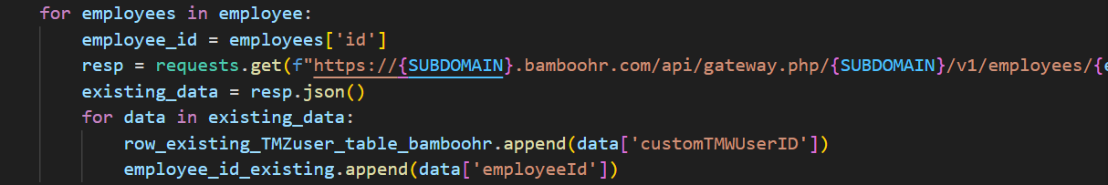
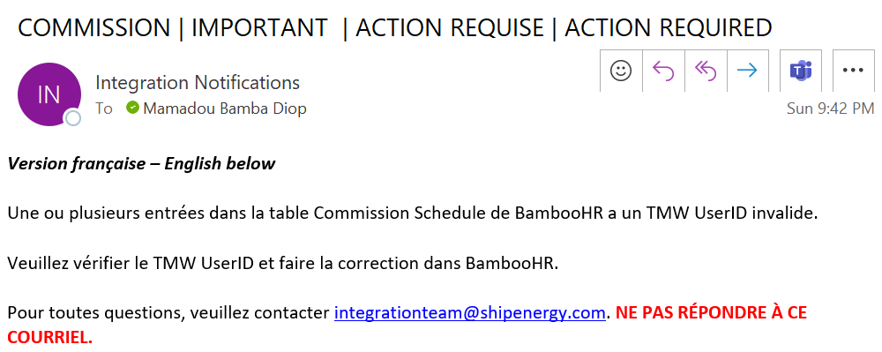
Verify TMW USERID in Bamboorh
Compare two tables: customTMWuserID in bamboorh and User_id in database (users)
Compare by providing these difference
Send email
Employee table in bamboorh
User_id in bhr database
Compare

Slide 10
Next Step: Insert the Updated rate bamboorh into our database

Slide 11
Thank you !

